Slide 1


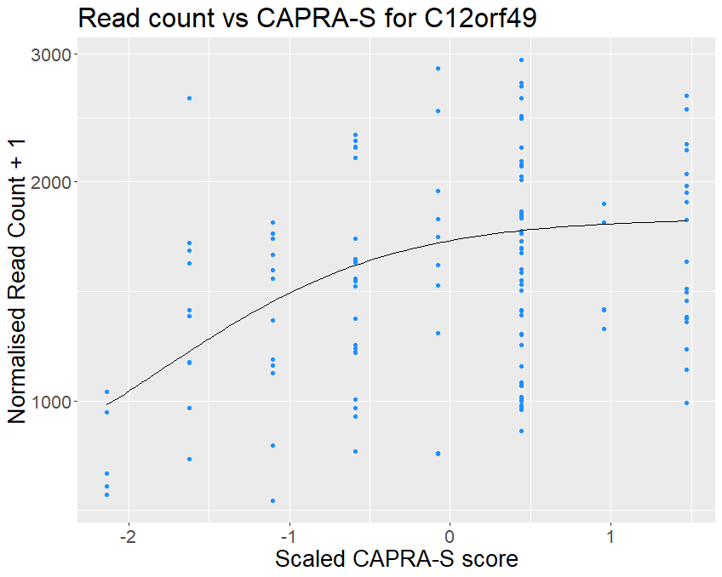
Pseudo-temporal mapping of transcriptomics changes to prostate cancer disease progression
Isobel Beasley: Bachelor of Biomedicine/Diploma in Mathematic Sciences
Primary Supervisor: Dr. Stefano Mangiola
Co-supervisor: Prof. Tony Papenfuss

Slide 2
Transcriptomic?
Transcriptome:
Gene Expression: How much gene product is being produced?
Transcription: Producing RNA from Genes
Quantified using RNAseq

Slide 3
Sudo-temporal changes?
Which genes change expression?
When do these changes happen?
In progression of disease (prostate cancer CAPRA-S score)

Slide 4
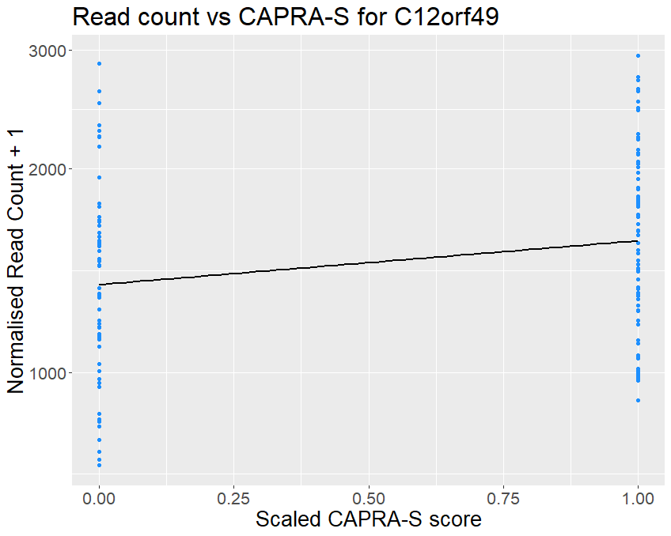
Current Approach
TABI (our approach)
How to find the when?

Slide 5
Results: Pattern of Gene Expression Changes
Early Prostate Cancer
Late Prostate Cancer
Cell cycle & Chromosomal Organisation E.g. mitotic spindle assembly (GO:0090307) | Skeletal and cardiac muscle contraction E.g. skeletal muscle thin filament assembly (GO:0030240)
Immunological Processes E.g. complement activation, classical pathway (GO:0006958) | Cell differentiation and adhesion Neuronal and synaptic development E.g. neuron differentiation (GO:0030182)
Direction of change
+ positive
Stage of prostate cancer
- negative

Slide 6
Biggest learning?
Bayesian Statistics

Slide 7


Conclusion:
New approach to ‘when’ in gene expression
Finding the ‘what and ‘when’ can reveal interesting patterns and tell us a lot about disease progression
Next Steps:
Simulating Datasets
Expanding to different cancers / diseases

